Slide 1
INFORMATION SECURITY SYSTEM DESIGN
Abdulkerim Ahmet Ünal 17030411027
Alper Doğukan Nizamoğlu 17030411050
Ayşegül Göktaş 17030411037
Furkan Salkın 17030411036

Slide 2
What is Sniffing?
Sniffing is a process of monitoring and capturing all data packets passing through given network. Sniffers are used by network/system administrator to monitor and troubleshoot network traffic. Attackers use sniffers to capture data packets containing sensitive information such as password, account information etc. Sniffers can be hardware or software installed in the system. By placing a packet sniffer on a network in promiscuous mode, a malicious intruder can capture and analyze all of the network traffic.

Slide 3
There are two types:
Active Sniffing:
Passive Sniffing:
Sniffing in the switch is active sniffing. A switch is a pointto point network device. The switch regulates the flow of data between its ports by actively monitoring the MAC address on each port, which helps it pass data only to its intended target. In order to capture the traffic between target sniffers has to actively inject traffic into the LAN to enable sniffing of the traffic. This can be done in various ways.
This is the process of sniffing through the hub. Any traffic that is passing through the non-switched or unbridged network segment can be seen by all machines on that segment. Sniffers operate at the data link layer of the network. Any data sent across the LAN is actually sent to each and every machine connected to the LAN. This is called passive since sniffers placed by the attackers passively wait for the data to be sent and capture them.

Slide 4
What is Address Resolution Protocol (ARP)?
How Does ARP Work?
How Does ARP Work?
When a new computer joins a LAN, it is assigned a unique IP address to use for identification and communication.
ARP caches are kept on all operating systems in an IPv4 Ethernet network. Every time a device requests a MAC address to send data to another device connected to the LAN, the device verifies its ARP cache to see if the IP-to-MAC-address connection has already been completed. If it exists, then a new request is unnecessary. However, if the translation has not yet been carried out, then the request for network addresses is sent, and ARP is performed.
Packets of data arrive at a gateway, destined for a particular host machine. The gateway, or the piece of hardware on a network that allows data to flow from one network to another, asks the ARP program to find a MAC address that matches the IP address. The ARP cache keeps a record of each IP address and its matching MAC address. The ARP cache is dynamic, but users on a network can also configure a static ARP table containing IP addresses and MAC addresses.

Slide 5
What Are the Types of ARP?
Proxy ARP
Gratuitous ARP
Reverse ARP (RARP)
Inverse ARP (IARP)

Slide 6
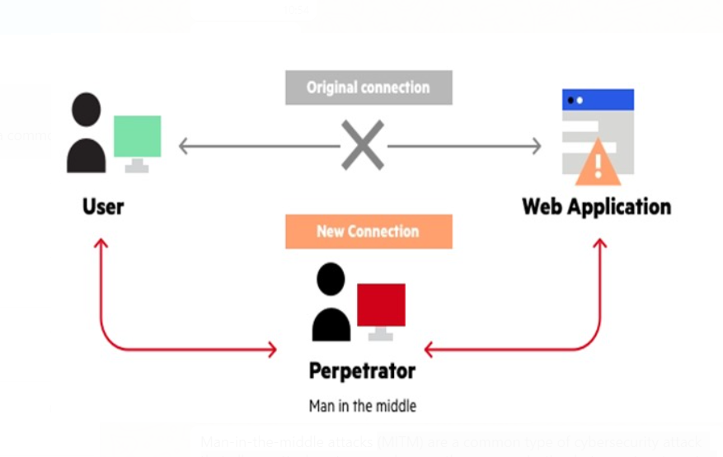
Man In-The Middle Attack
(MITM) are a common type of cybersecurity attack that allows attackers to eavesdrop on the communication between two targets. The attack takes place in between two legitimately communicating hosts, allowing the attacker to “listen” to a conversation they should normally not be able to listen to, hence the name “man-in-the-middle.

Slide 7
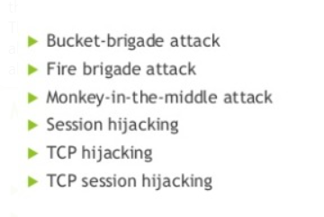
MITM attack is also known as:

